Slide 1
Drone Controller with Computer Vision Capabilities for the Tello EDU Mini Drone
Jacob E. Pitsenberger
Division of Science, Mathematics and Technology, Governors State University
CPSC-4900: Senior Project and Seminar
Professor Freddie Kato
May 4, 2023

Slide 2
This System provides…
An interface in which users can control the Tello EDU mini drone using their computer keys as input and receive the live video feed from its camera
Computer vision functionality such as object and facial recognition
2D flight path mapping
The ability to capture and store images, video, and other data from the camera feed and drone itself.
The ability to add face and object images for the drone to learn
The ability to capture and view flight data

Slide 3
These features can aid in solving many problems that exist in the world today
For example…
a drone with computer vision capabilities can be controlled to navigate through hazardous situations and identify people in distress so that a rescue team can then safely extract them.
a drone can be deployed as a mobile security system that can identify people as permitted personnel or trespassers.

Slide 4
Functional Aspects: Inputs – Processes - Outputs
A user creates an account to login to the management UI with by providing a username, password, first name, last name, and drone name.
Once an account has been created, they can login to the system to add face and object images to train the drone with, launch the drone controller program, and launch the mapping controller program.
To utilize the drone controller or mapping controller the user must first power on their Tello EDU drone and connect to its Wi-Fi. Upon doing this the management UI’s buttons for launching these programs can be pressed to launch their associated executable files.
Images, video, and flight logs captured through use of the drone controller are saved to these files respective directories upon pressing their associated button in the drone controller interface.
Maps captured through use of the mapping controller are saved to the Maps directory upon pressing the save map button in the mapping controller interface.
Captured flight logs can be viewed by launching the managementUI executable after ending a flight with the drone controller.

Slide 5
Technical aspects
Program Requirements
Python 3.10
Pillow~=9.4.0
opencv-python~=4.7.0.68
numpy~=1.24.1
djitellopy~=2.4.0
Operating System Requirements
Windows 8.1 or newer
Programming languages used
python programming language for all project code
C programming language for all SQLite code

Slide 6
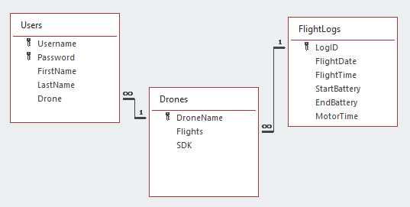
Data Storage
This project utilizes an SQLite relational database to store information on the systems users, the drone, and flight logs.
While this is good for storing these types of information it is not adequate nor efficient for storing and retrieving image and video files.
To overcome this issue, a collection of directories are created for and used by the system when images or videos of any type are needing stored/accessed.
These directories are initially empty until the system is used to populate them and include directories for Images, Videos, Maps, Faces, and Objects which all store image files.
The Database
Implemented as an SQLite database stored local to a user's computer.
The Users and Drones tables are populated each time a user creates an account using the add User frame.
Entries are added to the FlightLog table each time the drone controller is used to takeoff and land the drone.

Slide 7
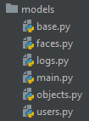
The Database/Data Storage Connection
database.py
This module contains variables that store the create table statements for the three database tables used by the system. In addition to this, a login function that is used to validate user login credentials and a function to get the name of the current user logged in are contained in this module. This module is imported for use in the models packages logs module, and users module as well as in the controllers packages login.py module.
users.py
This module contains the Users class with methods to access the variables in database.py that deal with information regarding the Users table. This class also inserts values into the drones table when a user is added.
logs.py
This module contains the logs class with methods to access the variables in database.py that deal with information regarding the flightlogs table.
faces.py
This module contains the faces class with methods to interact with the Faces directory.
objects.py
This module contains the objects class with methods to interact with the Objects directory.

Slide 8
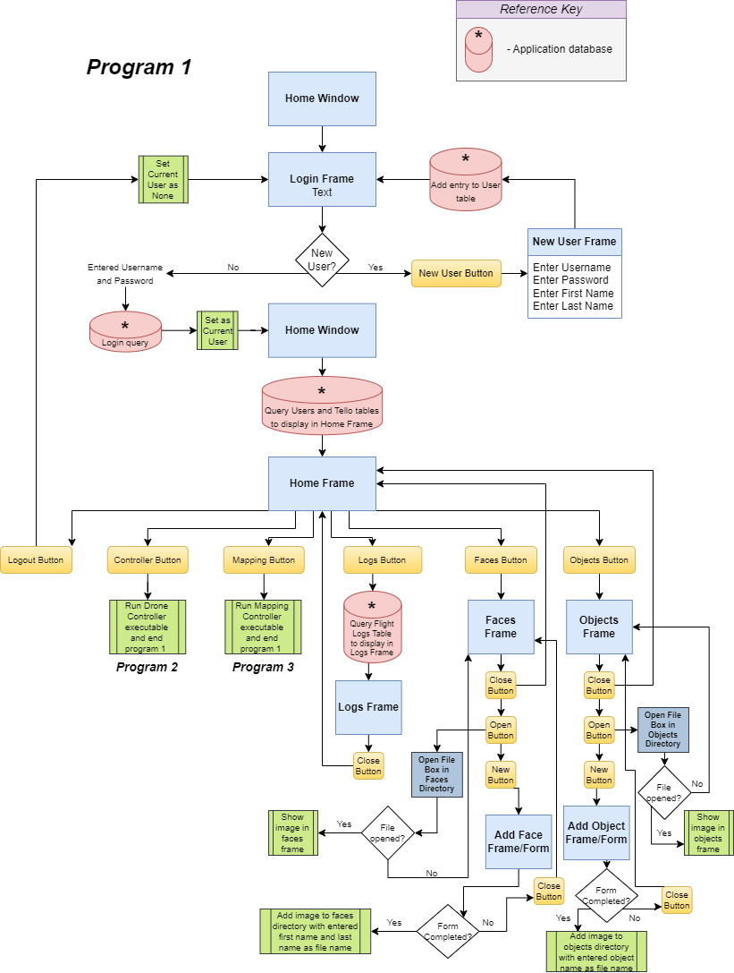
The Data Management System

Slide 9
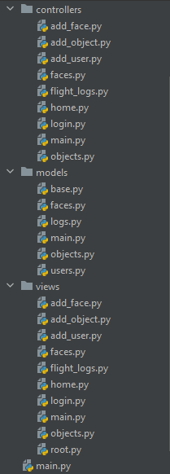
main.py (Controllers)
Controller class that initializes all other controller classes
method to determine if user is logged in
method to start the view class mainloop displaying login frame if user isn’t logged in or home frame if they are logged in
base.py (Models)
Inherited class for all models so they can register callback functions for events and trigger them
main.py (Models)
Model class that initializes Users, Faces, Logs, and Objects classes (models)
main.py (Views)
View class that initializes all other view classes and adds all frame classes to the root window.
method to switch between the frames in the root window.
method to start the root view as the mainloop
***Main function that initializes the Model, View, and Controller class and calls the Controllers classes start method. This is called in the python main loop contained in this module.***

Slide 10
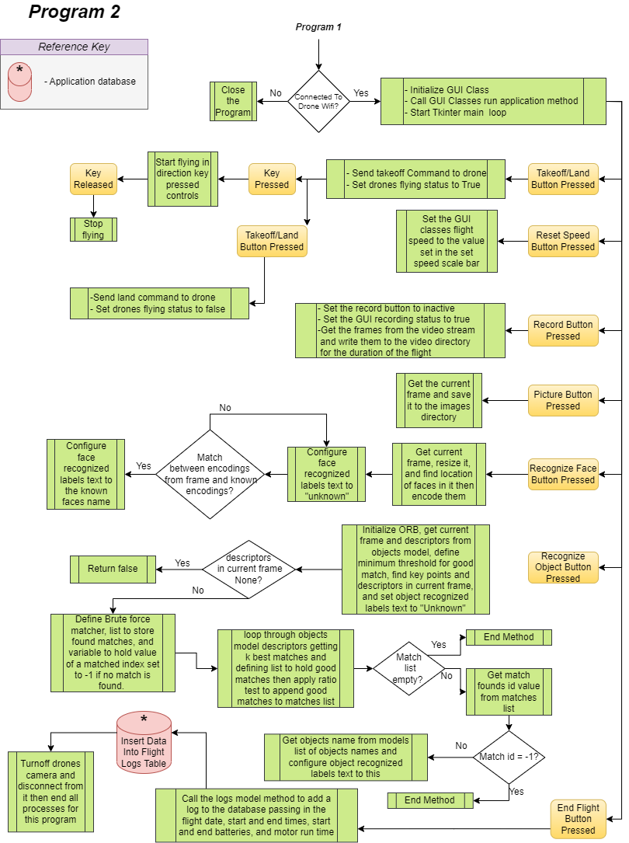
The Drone controller

Slide 11
main module:
GUI class with methods for takeoff/landing, ending flight, updating speed, taking pictures, recording video, adding flight logs to database, updating video feed, counting the faces in the video feed, recognizing faces in the video feed, recognizing objects in the video feed, and running the application.
python mainloop function to initialize the GUI and call the method to run the application.
Flight Commands module:
Fly function to take in a direction and drone and send rc controls in that direction to the drone
Start flying function that takes in an event, direction, drone, and speed sets the direction according to a button press events string equivalent, and calls the Fly function with this newly set direction and the speed and drone passed in as parameters
Function to stop flying by taking in an event and drone and sending rc controls to the drone to have the motors idle at the same speed.

Slide 12
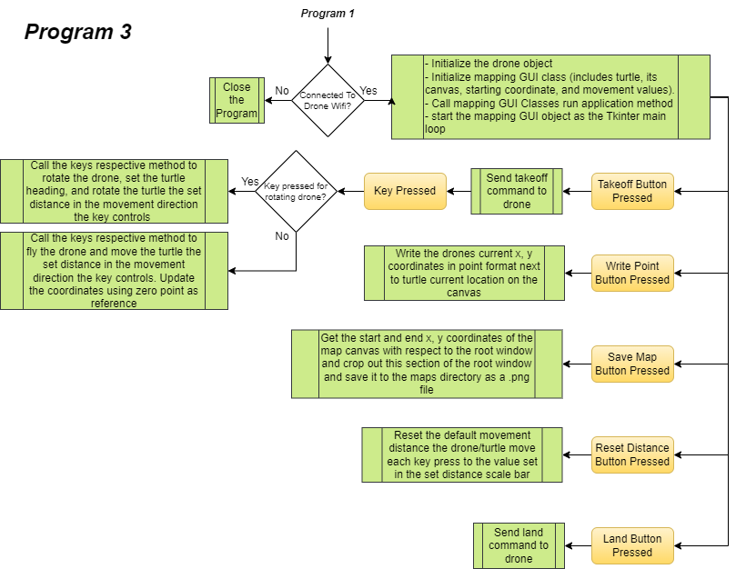
The Mapping Controller

Slide 13
main module:
MappingUI class with methods for sending commands to the drone, control the drone/mappers movements, updating the drones default movement distance, write the mapper/drones current position on the map as an (x, y) coordinate, save the map to the Maps directory, update the mappers coordinates relative to the drone, and running the application.
python mainloop function to initialize the Tello and GUI classes and run the GUI class as the Tkinter mainloop.
tello module:
This module was adapted from a TelloEDU wrapper class from the education online source One-Off Coder (<One-Off Coder > (<2019>) < Python, Manual Control> (<Version N/A>) [<Source code>]. https://tello.oneoffcoder.com/python-manual-control.html ). This class is used to interact with the TelloEDU drone and was adapted to only include the methods from the original source code used in the project for controlling the drone's movements and receiving responses from it. All other were deleted to reduce the amount of code factors relating to this class. Aside from this, all code for this module/class is directly from the source so all credit should be given as such.

Slide 14
Demonstrations

